Slide 1





JANATA SHIKSHAN PRASARAK MANDAL’S
BABASAHEB NAIK COLLEGE OF ENGINEERING, PUSAD – 445215 DIST. – YAVATMAL, MAHARASHTRA-INDIA (2024-25)
Project title : NEXT GENERATION SMART DUSTBIN WITH ADVANCE SMELL DETECTION MINIMIZING FALSE ALARMS THROUGH SELECTIVE SENSOR
TOPIC
INTRODUCTION TO SMART DUSTBIN
PRESENTED BY
MR. OM MANIK RAHUDKAR
GUIDED BY
DR. P. B. NIRANJANE
DEPARTMENT OF COMPUTER SCIENCEAND ENGINEERING
OMR
Notes:
1

Slide 2
Content
1
Abstract
7
Key Features in our
Smart Dustbins
2
Introduction
8
Technological Integration
3
Challenges with
Traditional Dustbins
9
Advantages
4
Why Need of Smart Dustbin
10
Disadvantages
5
What is a Smart
Dustbin?
11
Conclusion
6
Smart Dustbin Evolution
12
Reference
OMR
Notes:
1

Slide 3
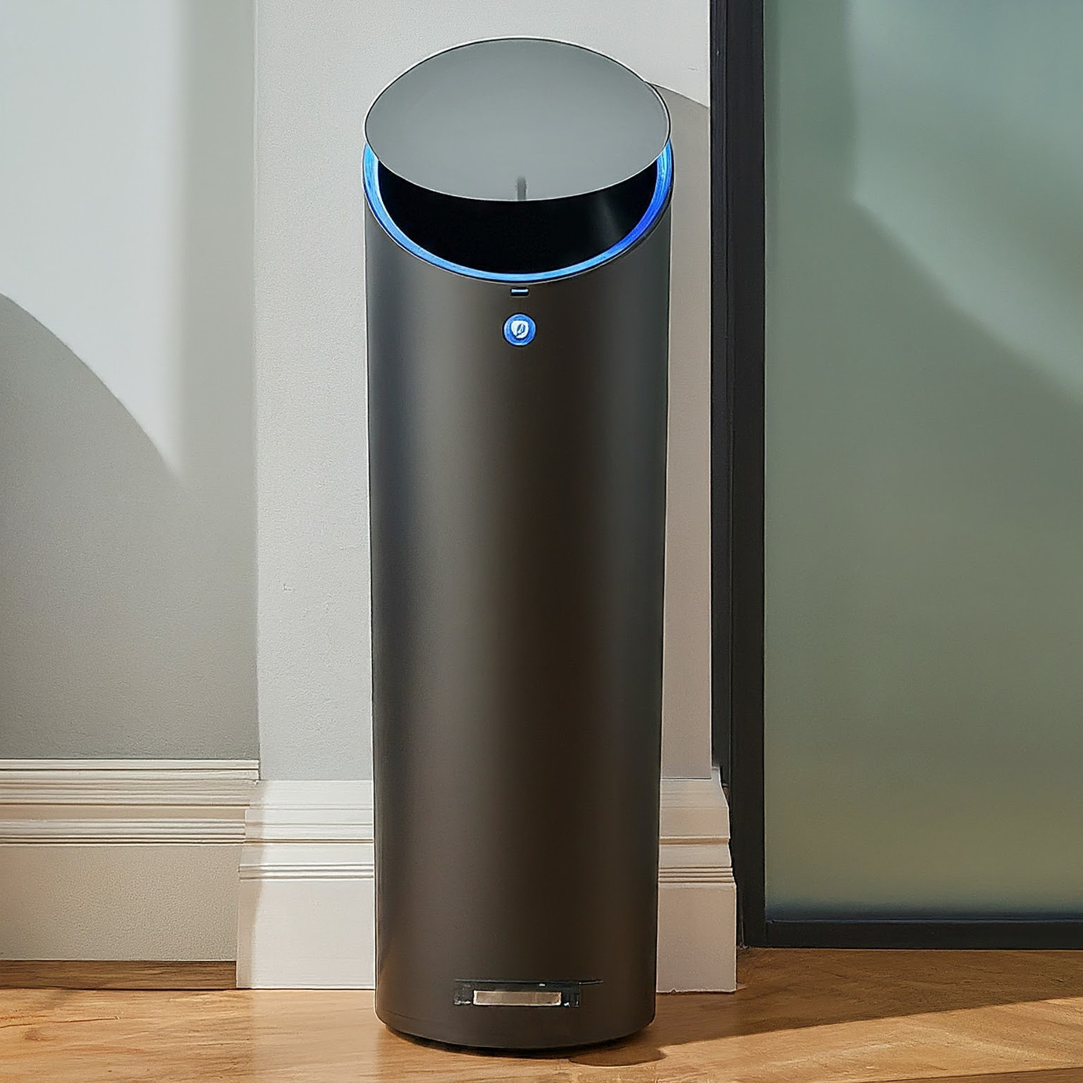
Abstract
The Smart Dustbin is an innovative solution .
IoT connectivity enables optimized waste collection routes.
Smart bins, powered by solar energy.
Improving efficiency and hygiene in urban areas.
Smart
Dustbin
OMR
Notes:
1

Slide 4

Introduction of Smart Dustbin
Smart dustbins integrate IoT and sensor technology for real-time waste monitoring, segregation, and automated disposal.
OMR
Notes:
1

Slide 5

Challenges with Traditional Dustbins
Manual Operation
1
Hygiene issues and lack of real-time monitoring.
Overflowing Bins
2
No alert systems for full bins leading to waste buildup.
Odor Issues
3
Spread of unpleasant odors from traditional dustbins.
OMR
Notes:
2

Slide 6

Why Need of Smart Dustbin
Overview of current inefficiencies in waste management.
Environmental and health issues from overflowing Dustbins.
Spread odour from the Dustbins.
Smart dustbins as a solution to real-time monitoring and collection.
Smart
Dustbin
OMR
Notes:
3

Slide 7
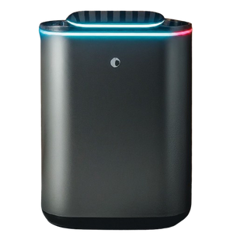
Smart
Dustbin
What is a Smart Dustbin?
Technology
Key Features
Data Collection
Sensors, microcontrollers, and IoT integration.
Waste level monitoring, odor detection, automatic lid control.
Real-time data for optimized waste management.
OMR
Notes:
3

Slide 8
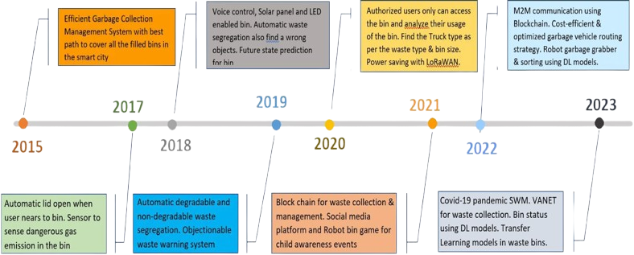
Smart Dustbin Evolution
OMR
Notes:
3

Slide 9
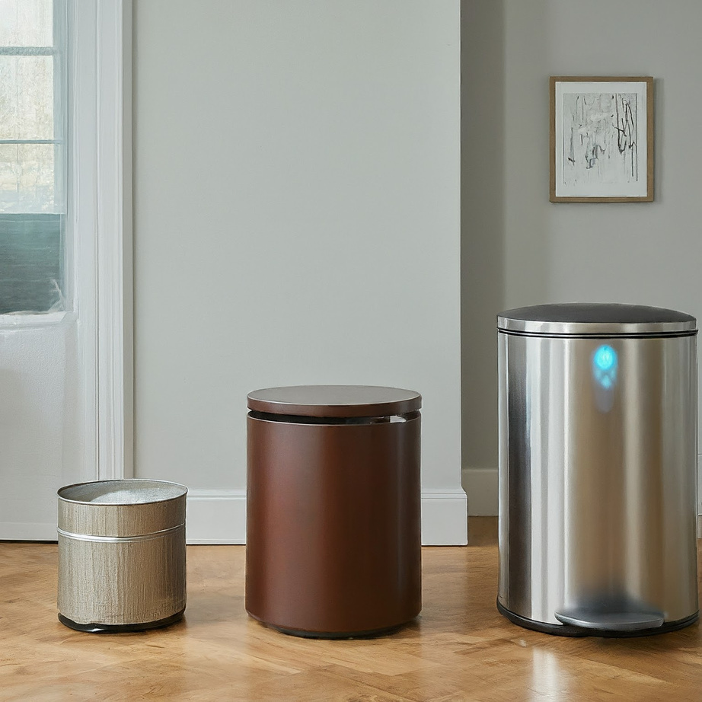
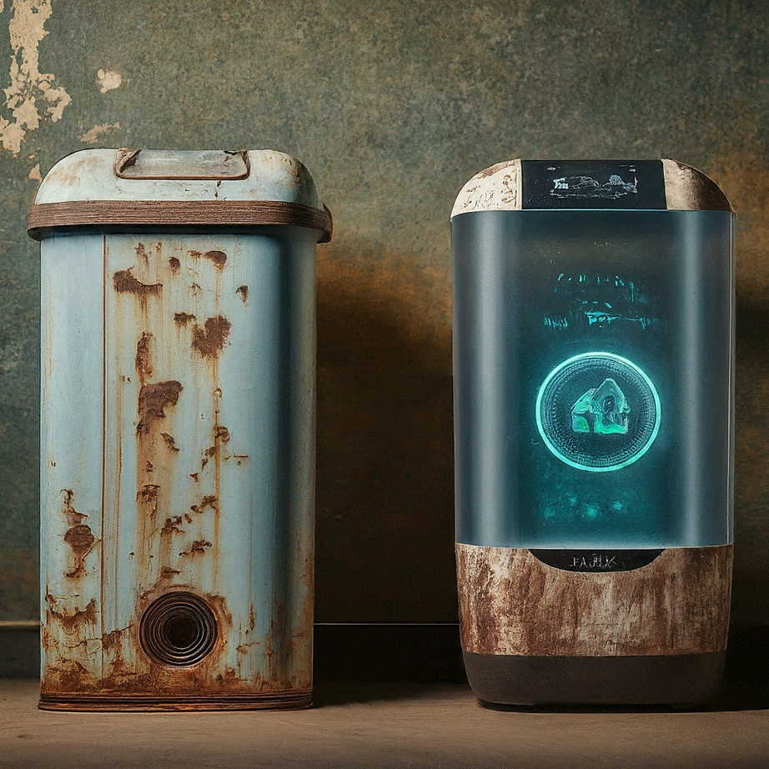
Smart Dustbin Evolution
2015
1
Waste level monitoring and automated lid control.
2019
2
Automatic waste segregation and solar-powered bins.
2023
3
The blockchain system is integrated with other technologies to record data on waste collection and treatment
OMR
Notes:
4

Slide 10
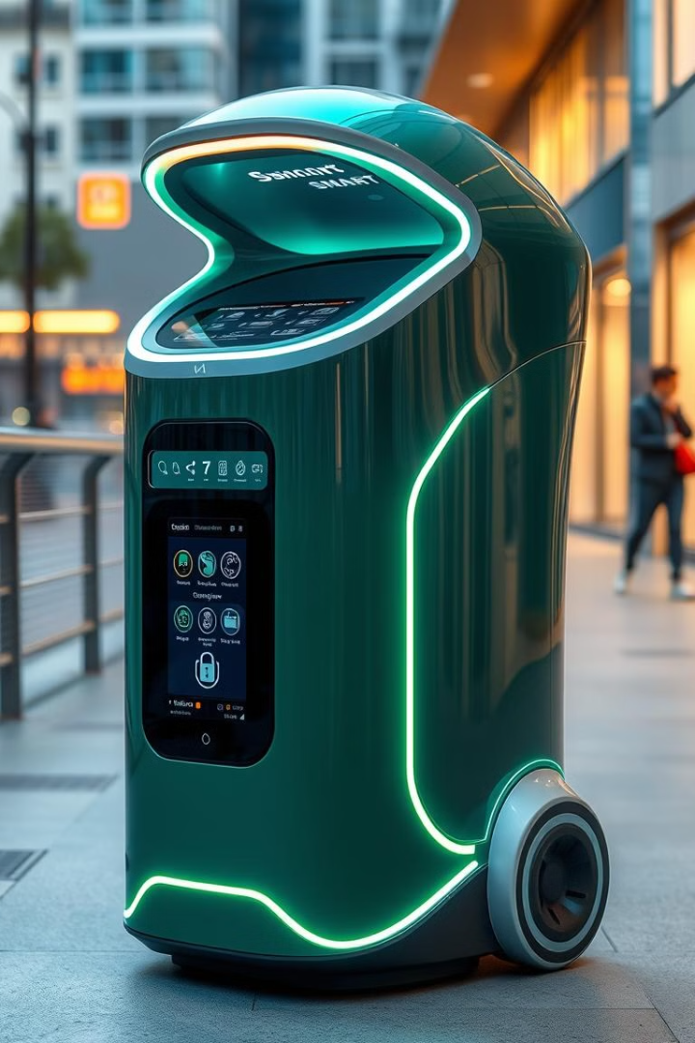




Key Features of Smart Dustbins
Selective Odor Detection
Minimizes false alarms through selective sensing.
Waste Segregation
Automated sorting of wet and dry waste.
Automated Lid Control
Efficient waste disposal and odor containment.
Fire Detection
OMR
Safety alerts via mobile app for quick response.
Notes:
5

Slide 11
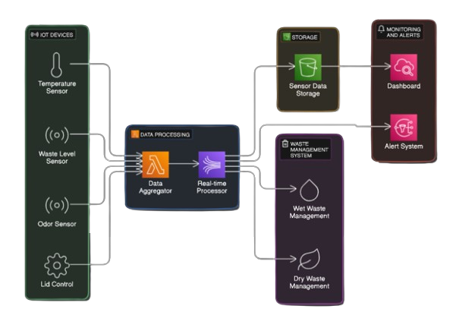
Smart Dustbin Architecture
ESP8266
OMR
Notes:
5

Slide 12
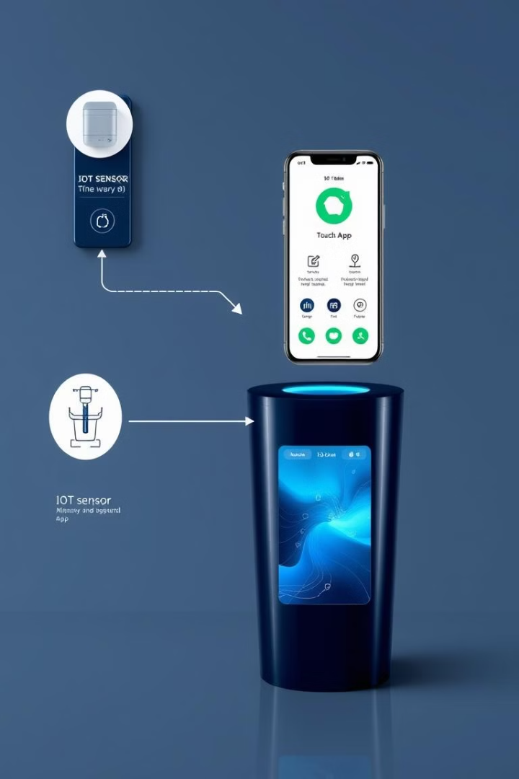




Alarms
Technological Integration
Blynk App
IoT Integration
Communication with waste management systems.
Real-time Monitoring
Mobile app (Blynk) for data visualization.
Optimized Collection
Automatic waste sorting and route planning.
OMR
Notes:
6

Slide 13

Advantages of Smart Dustbins
Cost-Efficiency
Sustainability
Reduced operational costs through automation.
Improved waste management and environmental impact.
Hygiene
Efficiency
Automated disposal and containment of odors.
Real-time monitoring and optimized collection routes.
OMR
Notes:
7

Slide 14

Disadvantages of Smart Dustbins
High Initial Cost
1
Significant investment required for implementation.
Maintenance Challenges
2
Potential issues with sensor reliability and upkeep.
Dependency on Technology
3
Reliance on IoT and mobile app functionality.
OMR
Notes:
8

Slide 15

Conclusion
Transformative Solution
Smart dustbins offer a revolutionary approach to waste management.
INDIA
in
2050
Long-term Benefits
Improved efficiency, hygiene, and sustainability despite high initial cost.
Ideal for Smart Cities
Adoption in large public spaces and urban areas.
OMR
Notes:
9

Slide 16



Thank You!
For more information, please visit our E-mail or contact us.
By Om Rahudkar
+91 885-780-0548
omrahudkar@gmail.com
Notes:
10

Slide 17
Reference
Menaka Pushpa Arthur1,3 · S. Shoba2Aru Pandey .
”A SURVEY OF SMART DUSTBIN SYSTEM USING THE IOT AND DEEP LEARNING” Accepted: 19 December 2023 / Published online: 15 February 2024© The Author(s) Artifcial Intelligence Review
K. Lova Raju, Member, IEEE, Md. Abbas Hussain, KVNS. Umesh Chandra, V. Naga Phanendhra, D. Narendra K.
” IOT BASED DUST BIN MONITORING SYSTEM USING NODE MCU”978-1-5386-8190-9/19/ 2019 IEEE
Hassan Jaba,Rosilah Hassan,Abdulrahman Sameer Sadeq.”NEW SMART WASTE MANAGEMENT SYSTEM” 978-1-7281-5249-3/20$31.00 ©2020 IEEE
OMR
Notes:
10

